Slide 1
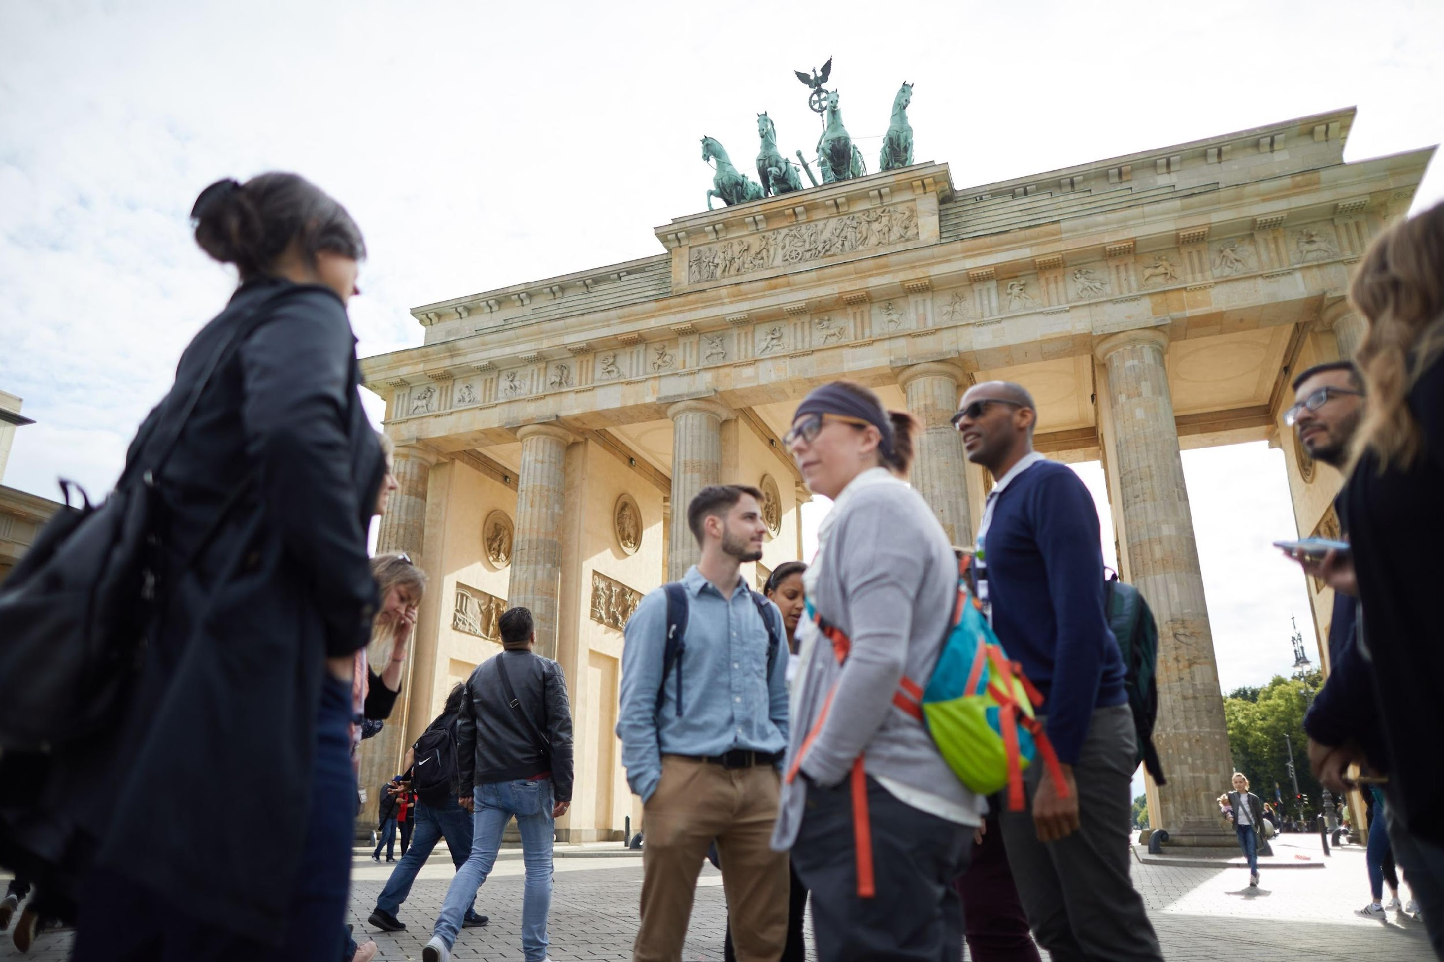

WELCOME TO A TOP WORKSHOP
presented by Leader Name

Slide 2
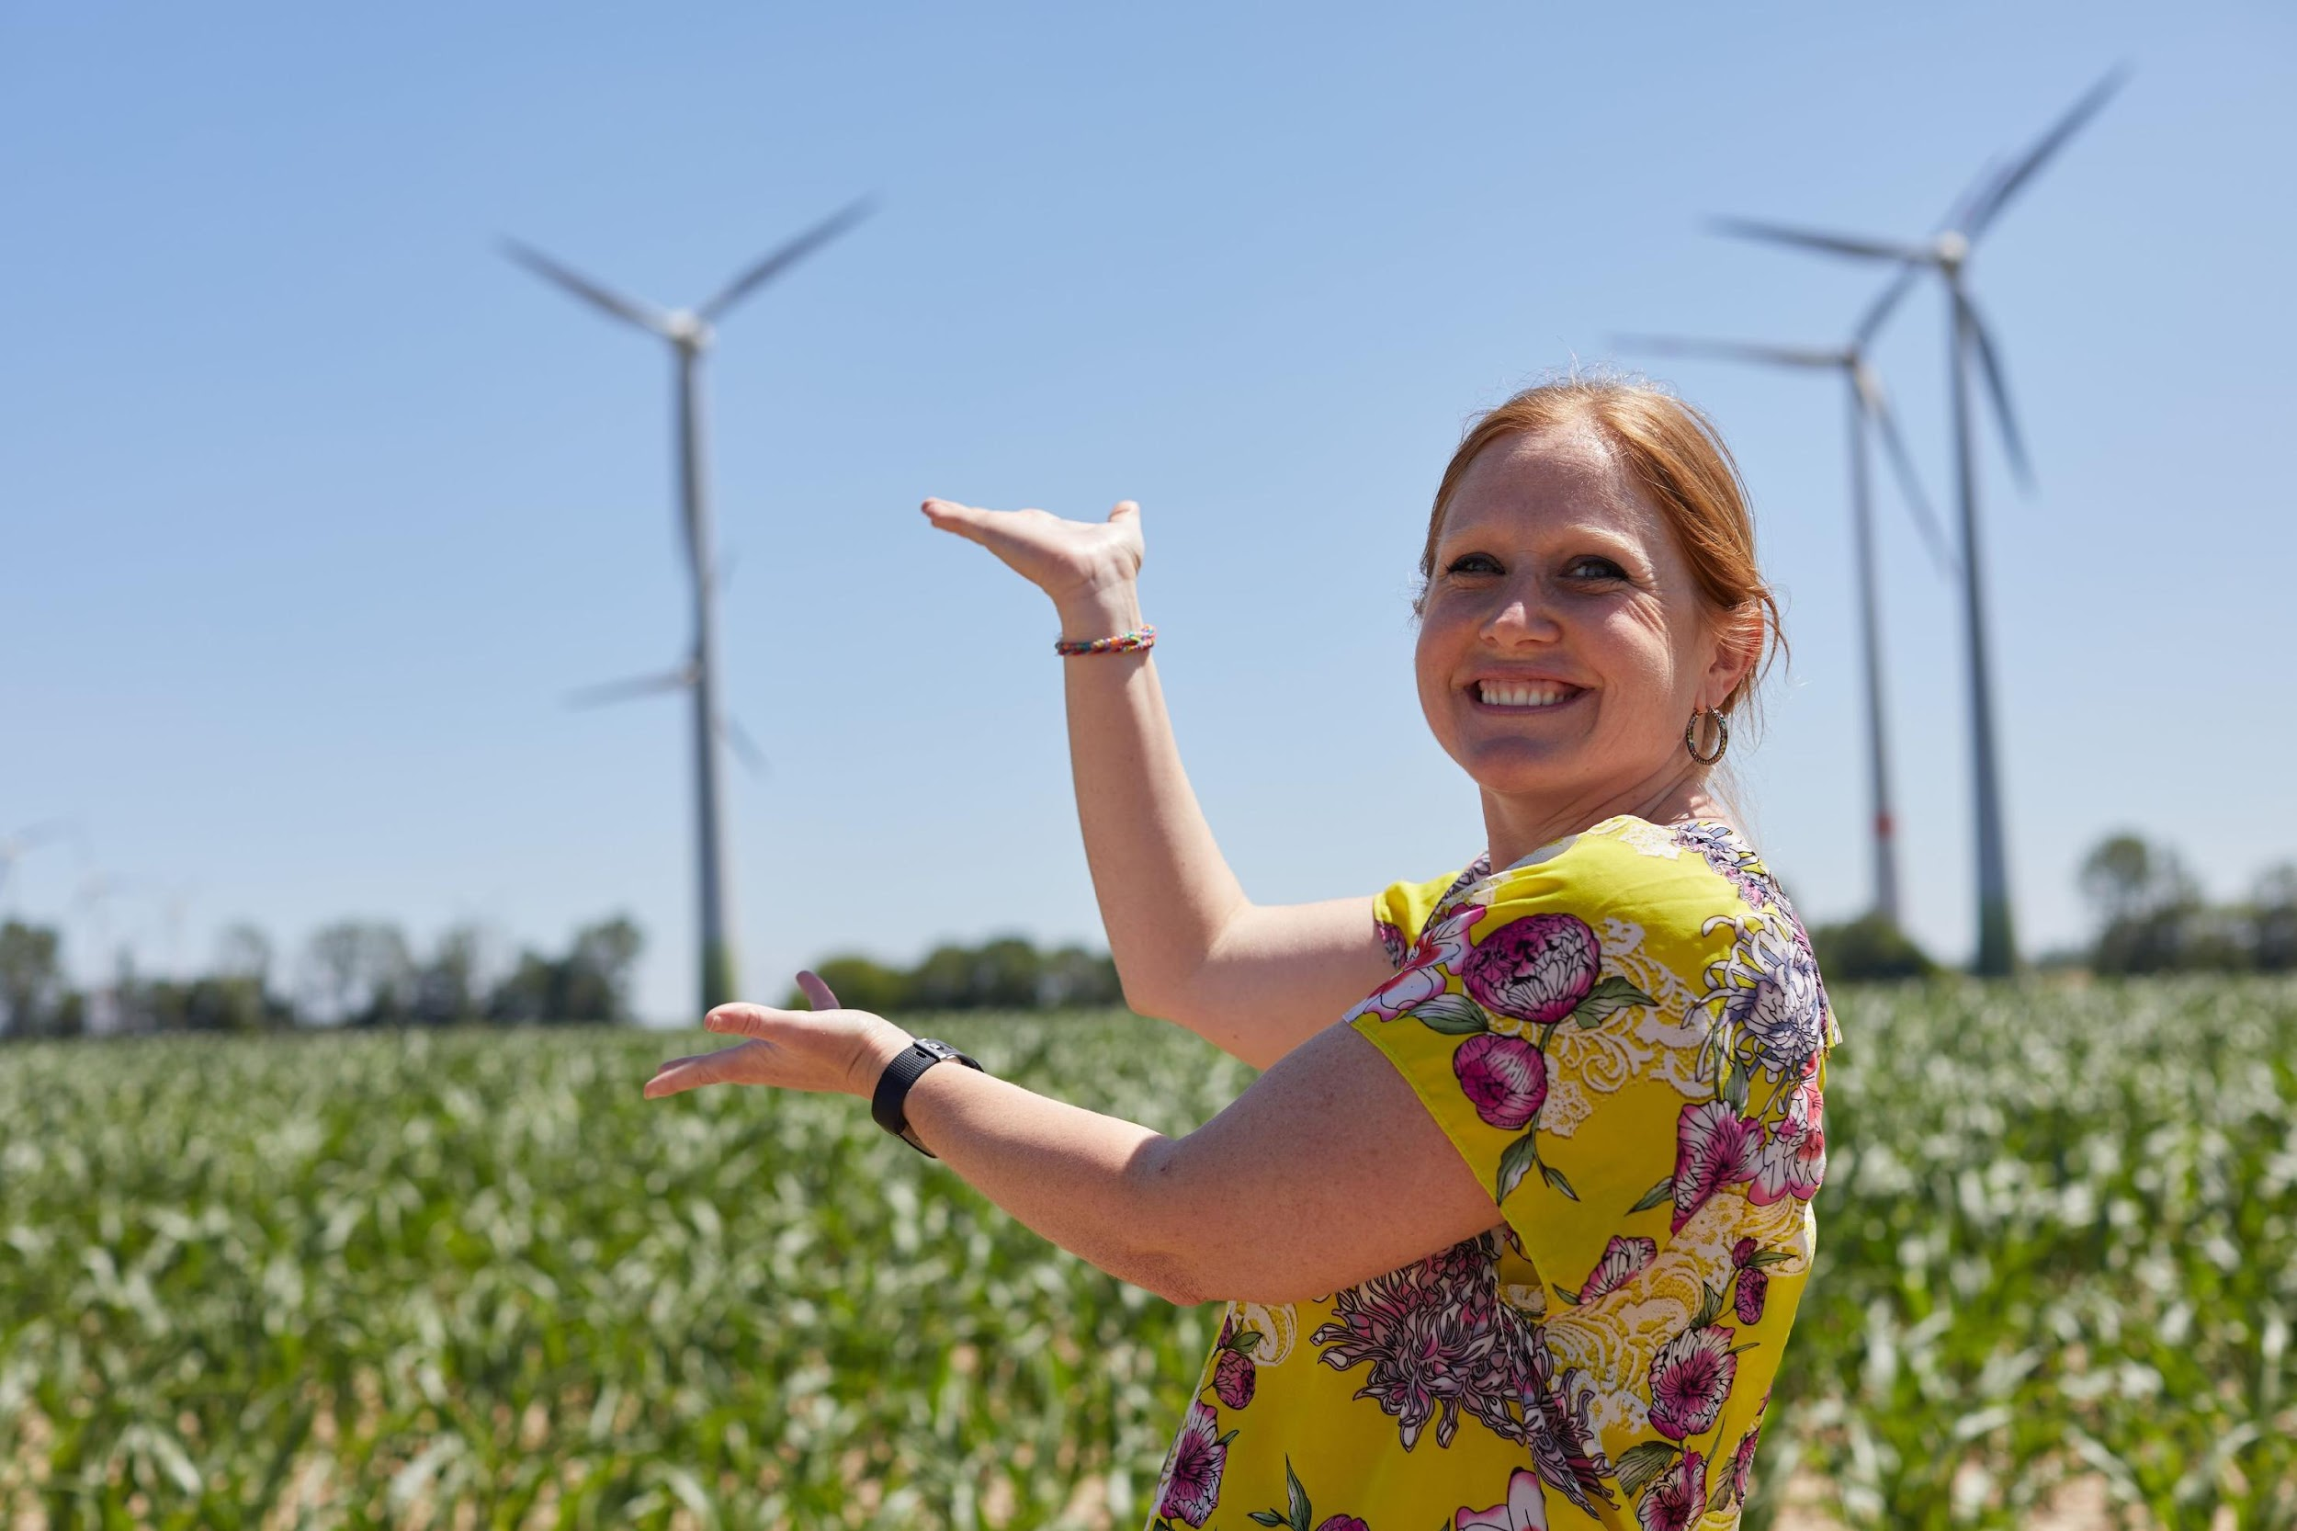
AGENDA
INTRODUCTIONS
ICE BREAKER ACTIVITY
ABOUT TOP
TOP MATERIALS + SAMPLE LESSON
BREAKOUTS
STUDY TOUR APPLICATION
Q&A

Slide 3
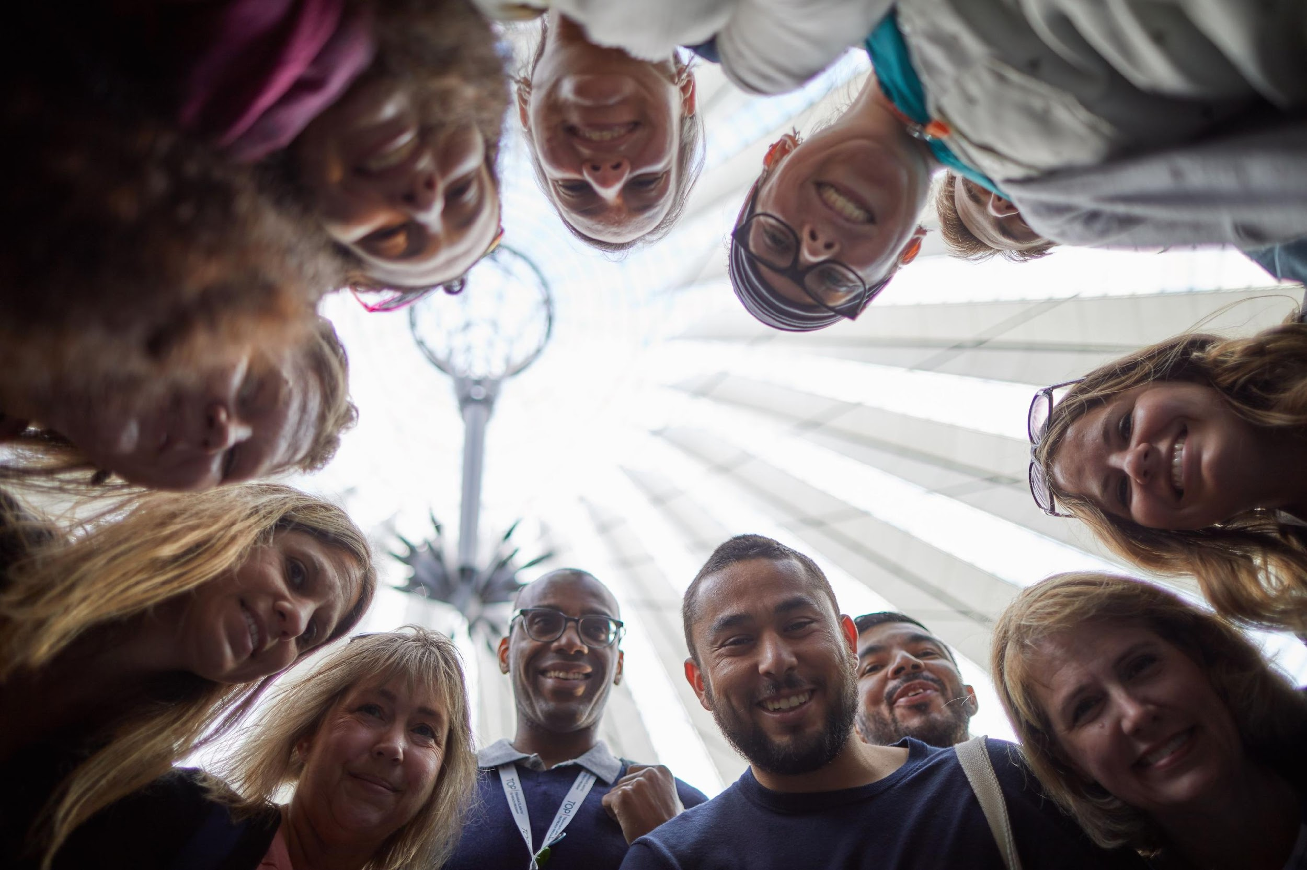
INTRODUCTIONS

Slide 4
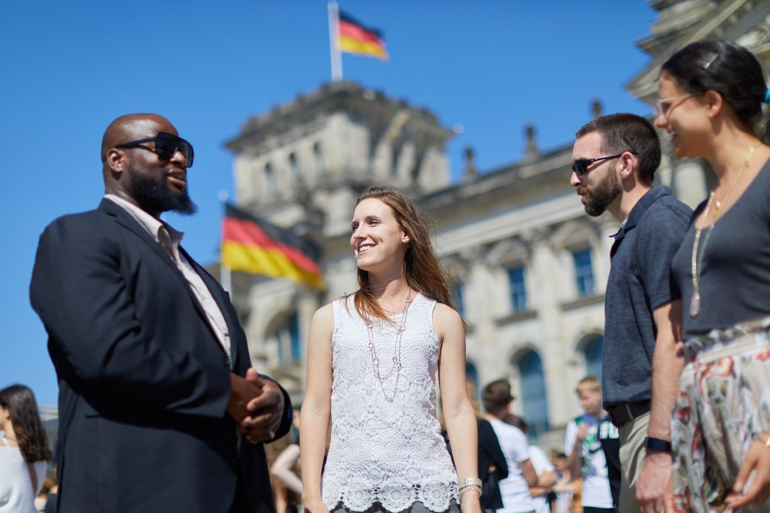
ICE BREAKER ACTIVITY

Slide 5
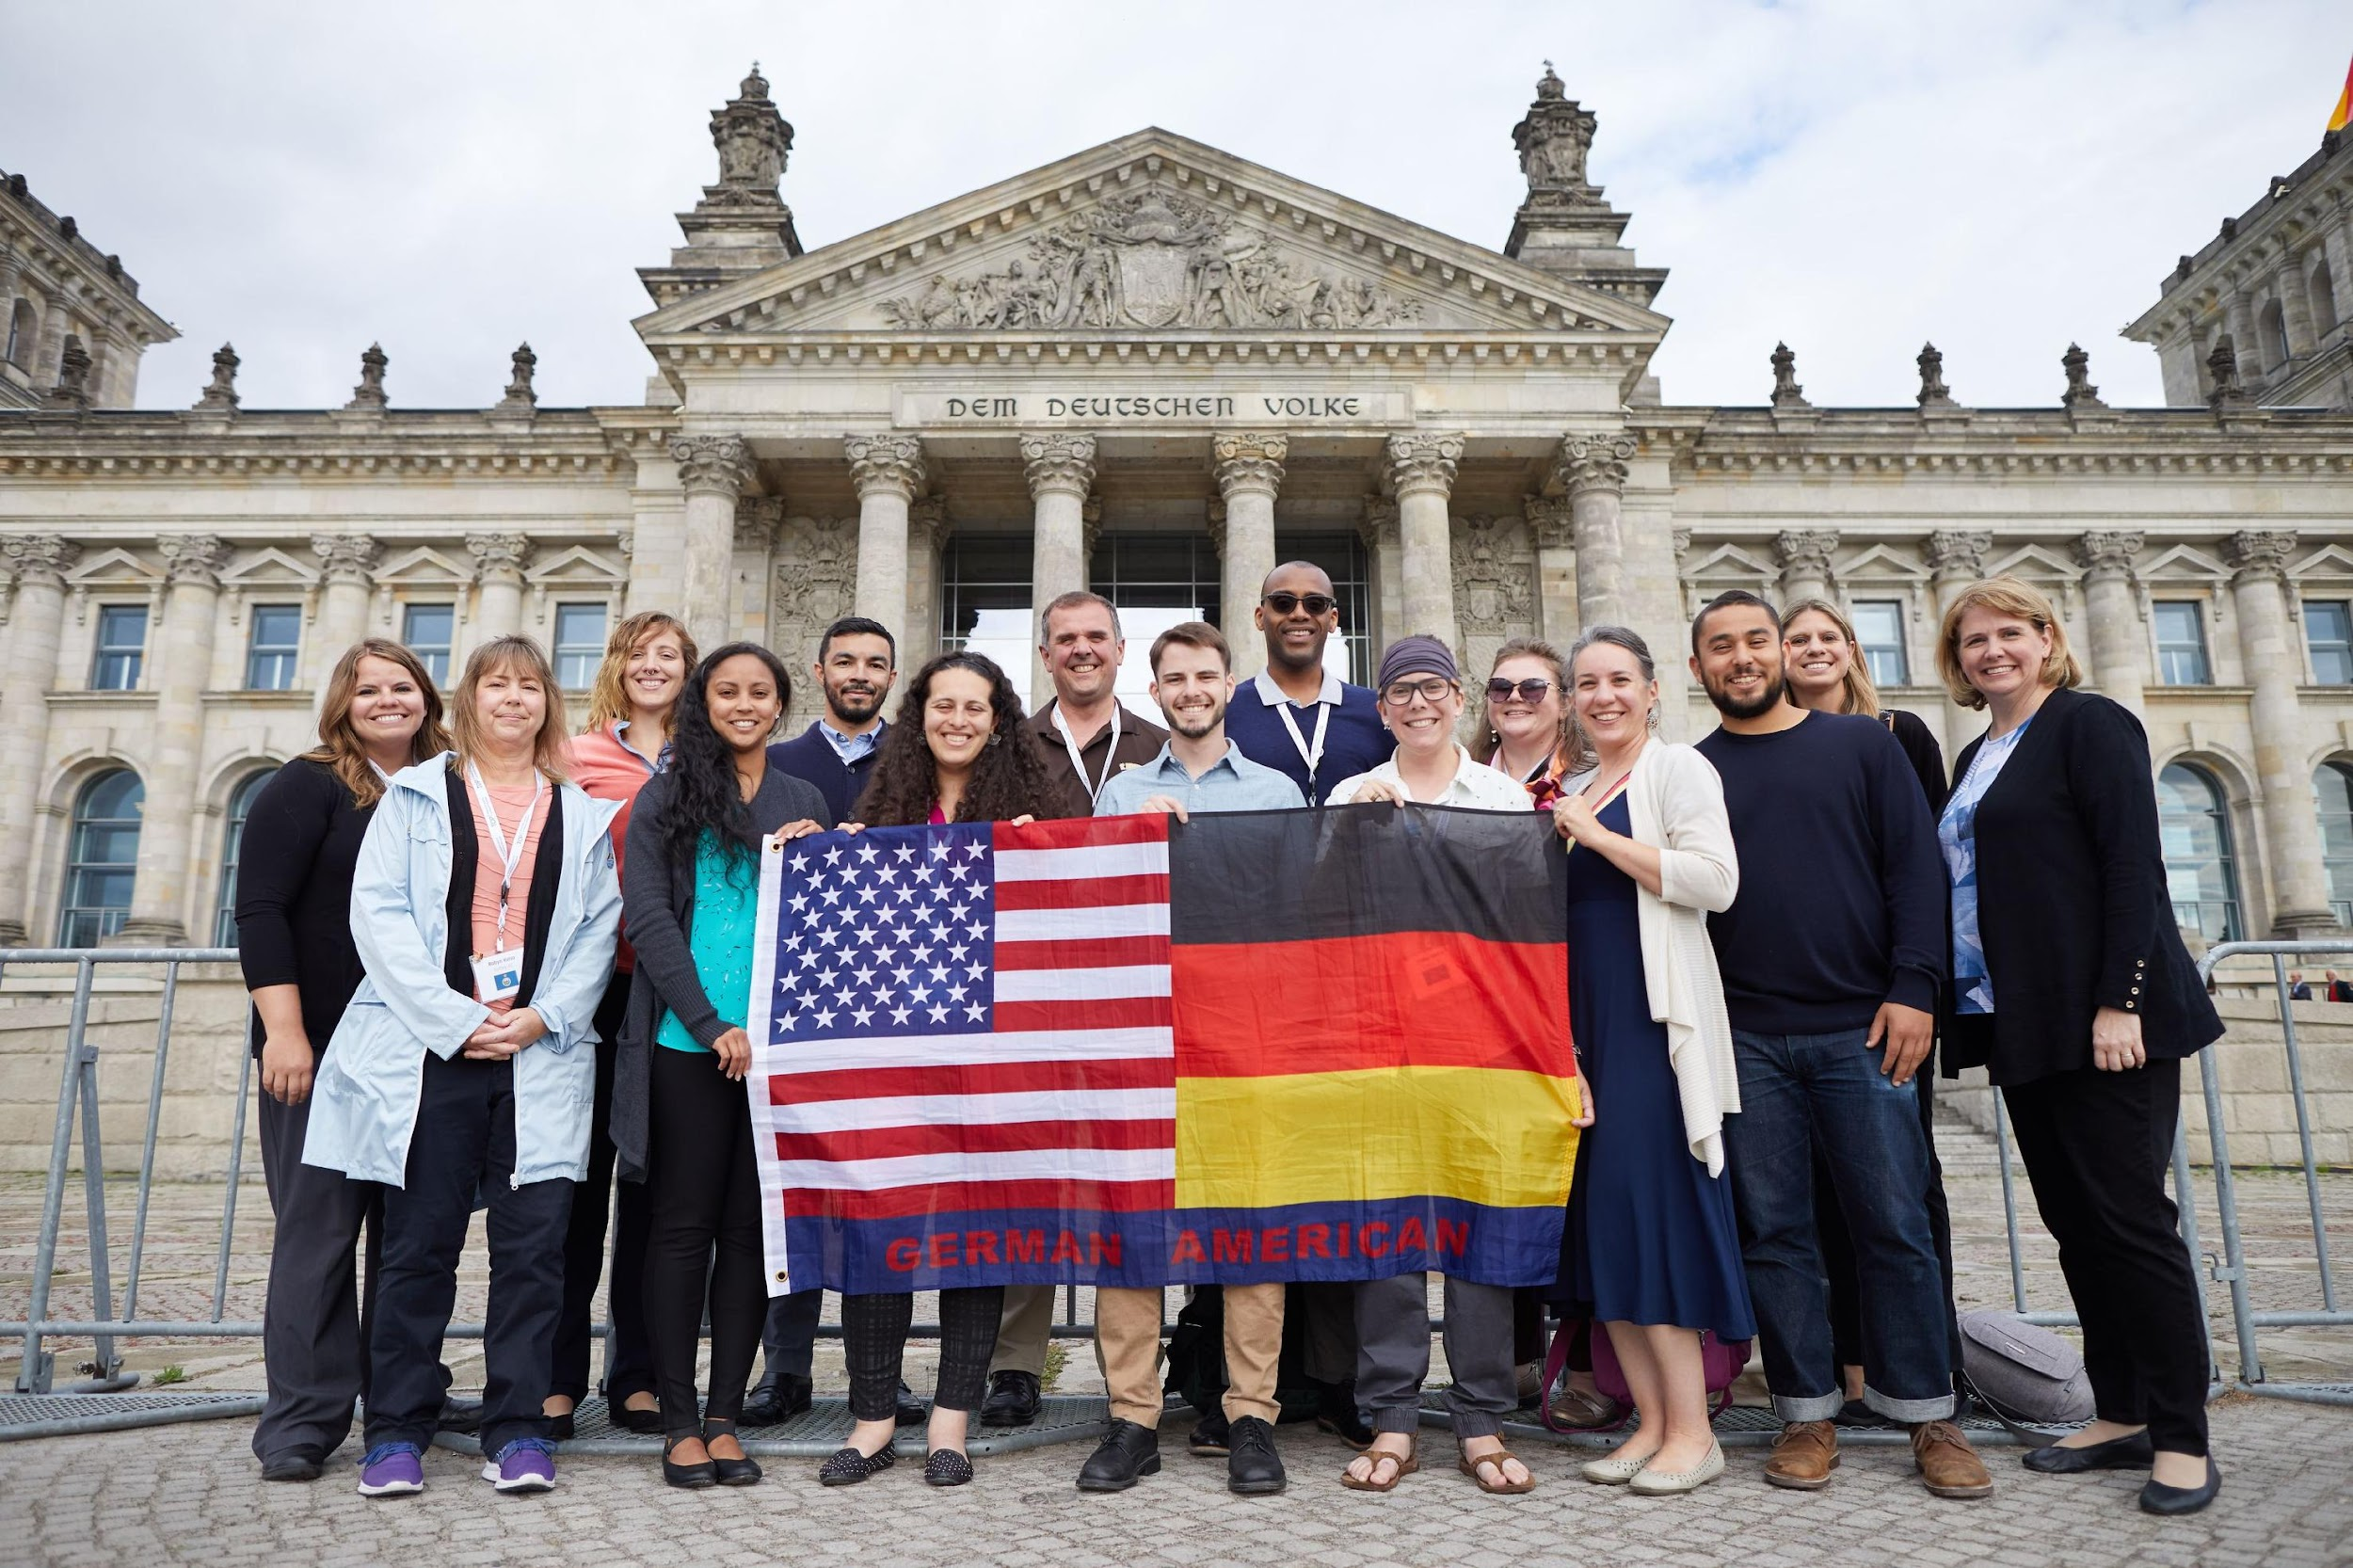
ABOUT TOP

Slide 6
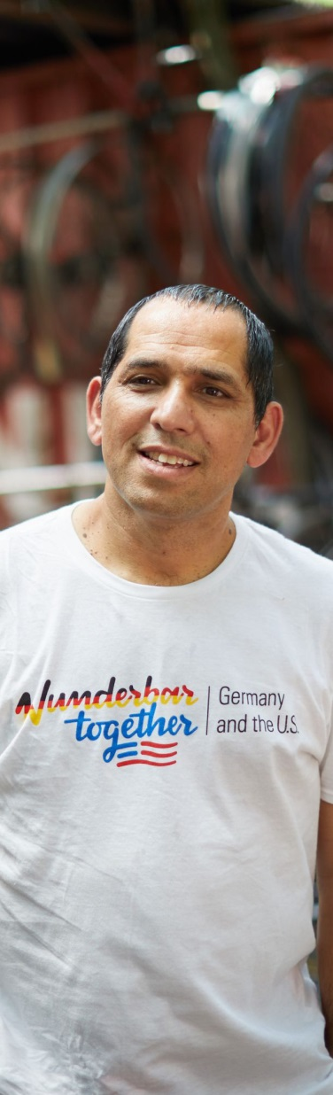
ABOUT TOP
Founded: 2002
Office: Goethe-Institut Washington, DC
Staff: 3x Full-Time
Provide information about contemporary Germany:
Education, Dialogue, Experience
For social studies and STEM educators

Slide 7

EDUCATION
TOP produces (FREE) teaching materials
Nearly 10,000 hardcopies provided to workshop attendees, annually
Instructional guides, newsletters, films, DVDs, wall maps, and more

Slide 8

DIALOGUE
TOP sponsors workshops
Nearly 250 annually
Over 3,000 combined attendance annually
Virtual workshops a growing trend

Slide 9

EXPERIENCE
TOP sends educators to Germany
55 annually
All expenses paid ($350 refundable deposit)
Summer study tour duration: two weeks
Applicants from US (50+DC) plus Canada
No TOP study tour has the same itinerary

Slide 10
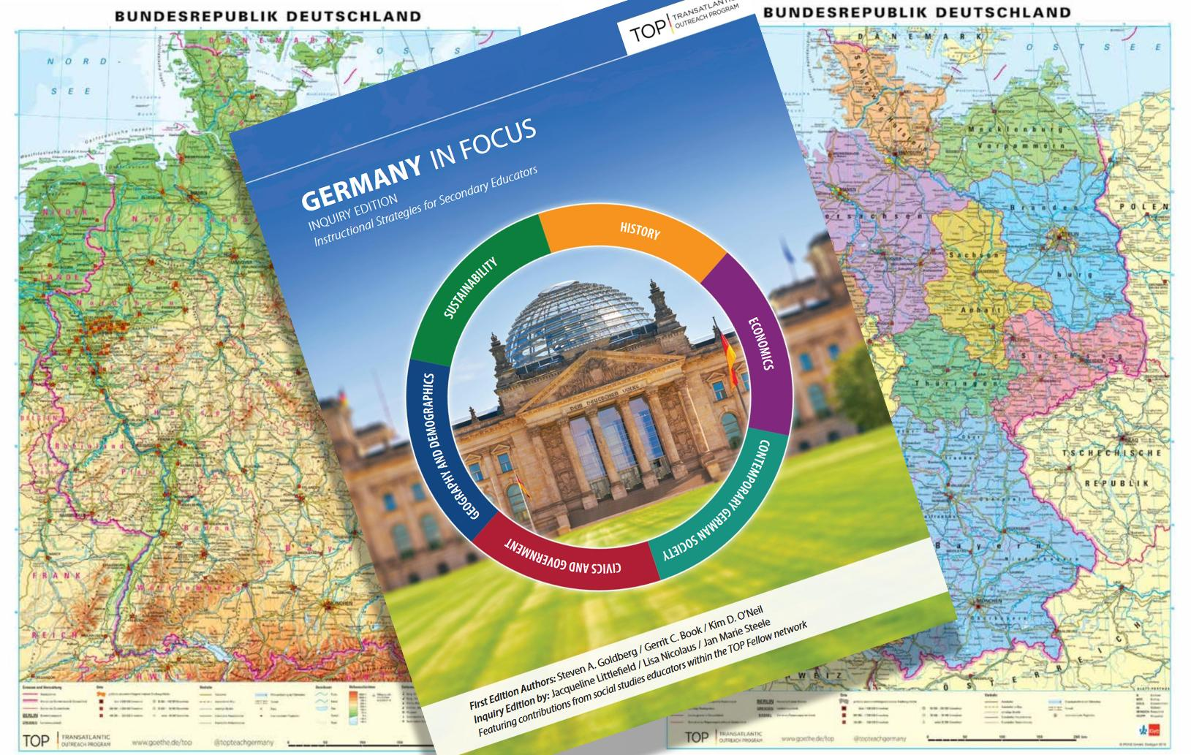
TOP MATERIALS

Slide 11
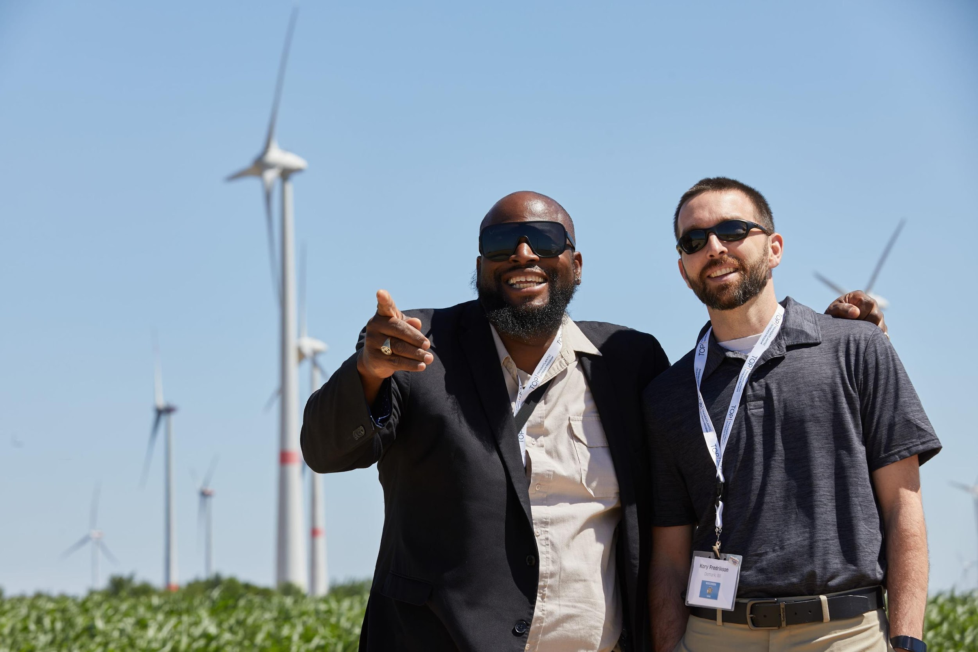
BREAKOUT ROOMS

Slide 12
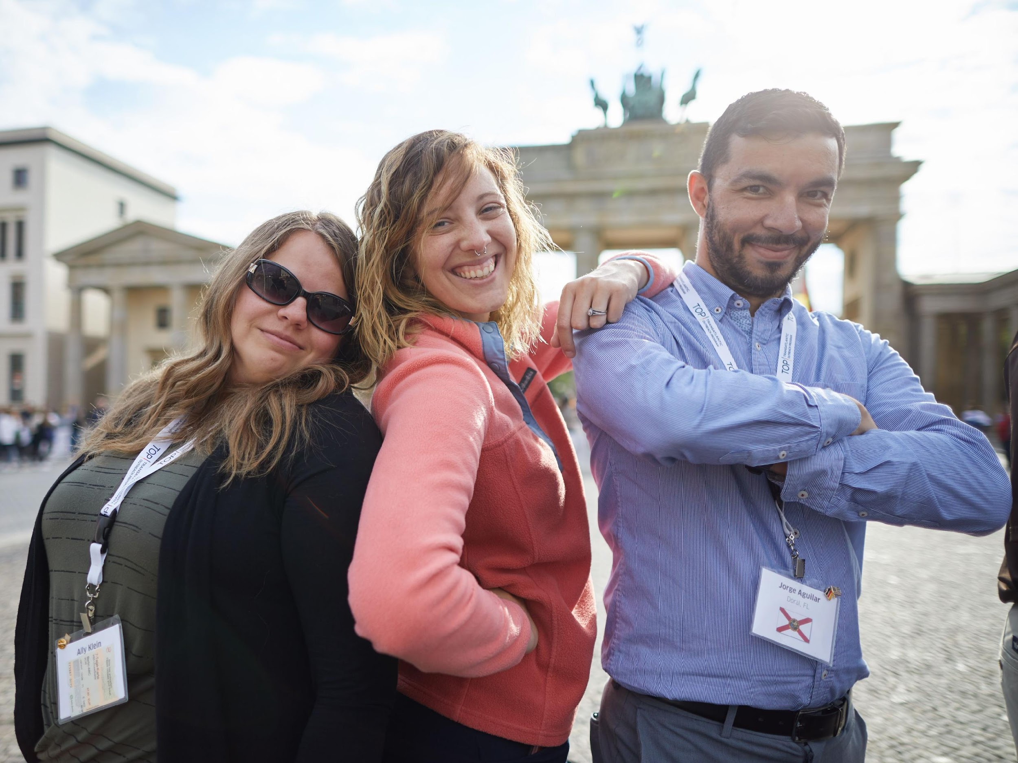
APPLICATION PROCESS

Slide 13
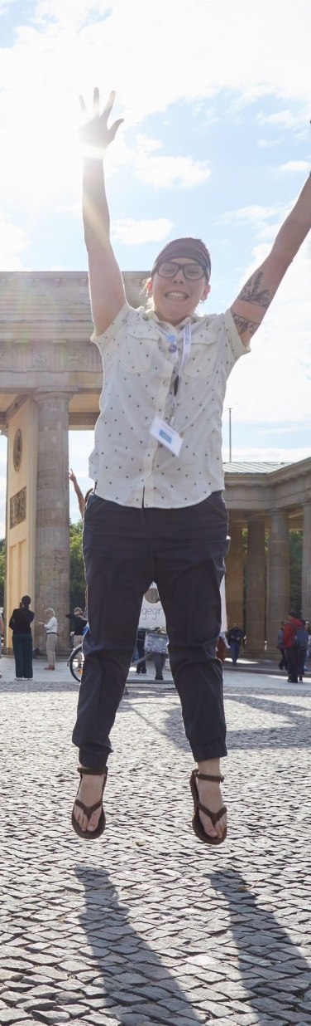
APPLICATION STRATEGY
Read the FAQ! Do NOT wait to start!
Application timeline: October-January
Average time requirement: 10 hours +/-
Ask someone to proof-read
Be prepared to submit a lesson
Keep it student & peer focused!

Slide 14
10 HOURS!?! (or more)
TOP is looking for the best qualified educators
25-33% applicant success rate
Over $7,000 USD investment per study tour participant
Post-tour requirements:
Inquiry lesson + workshop

Slide 15

CONTACT
Web: www.goethe.de/top
Social media: @topteachgermany
E-mail: top@goethe.de

Slide 16
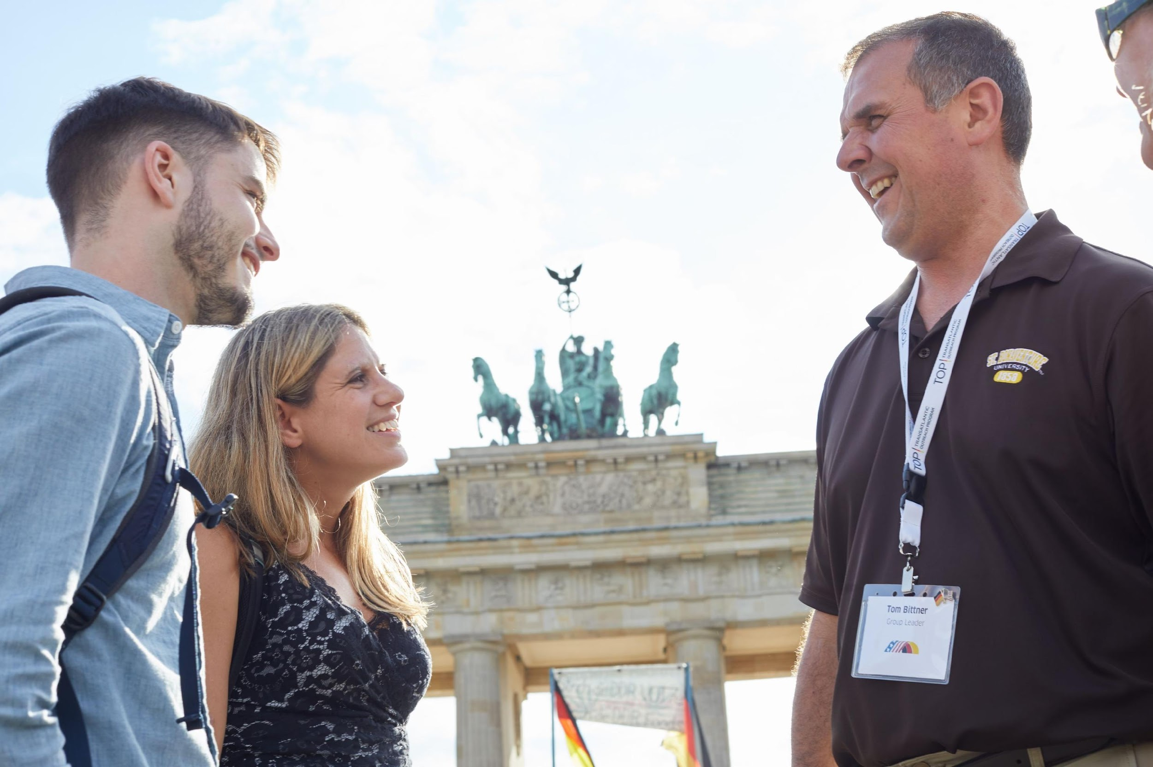
Q&A

Slide 17
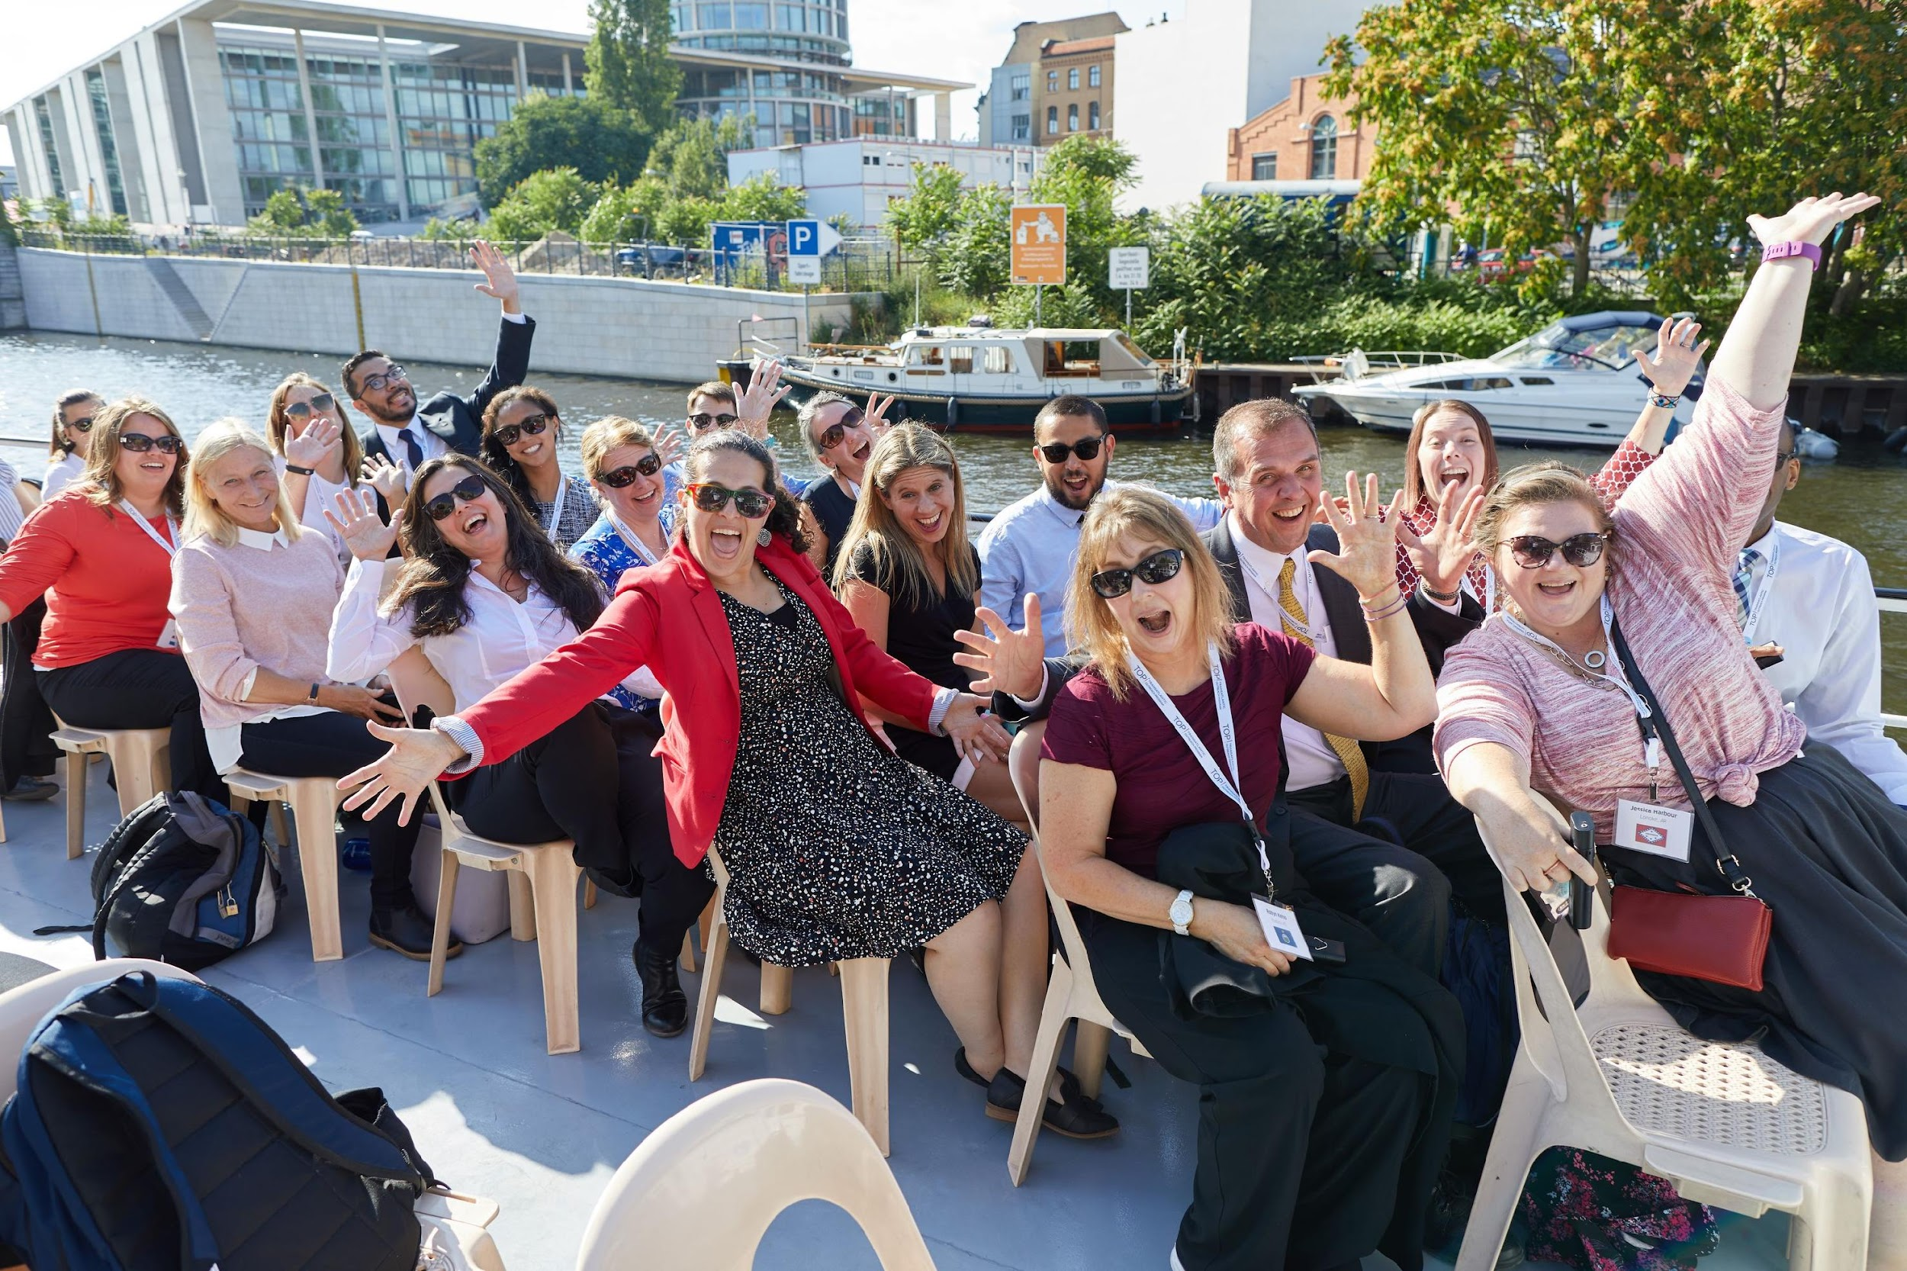
AUF WIEDERSEHEN

Slide 18


SPECIAL THANKS:
ALL PHOTOS COURTESY OF BERNHARD LUDEWIG
TOP IS A PUBLIC / PRIVATE PARTNERSHIP

